Slide 1
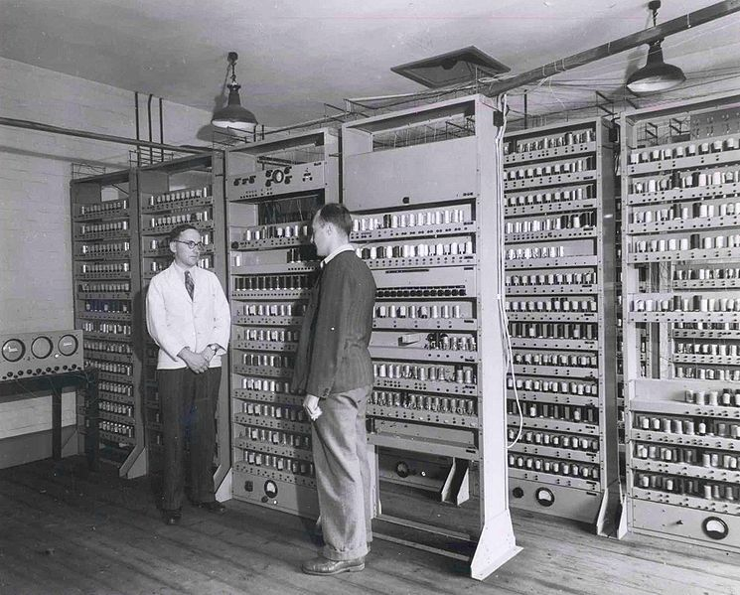
© Copyright Computer Laboratory, University of Cambridge. Reproduced by permission. [http://www.cl.cam.ac.uk/Relics/archive_photos.html == Licensing == {{cc-by-2.0}}
No changes made to image.
Maurice Wilkes, Bill Renwick and Electronic Delay Storage Automatic Calculator (EDSAC). The second electronic, digital, stored program computer in operation. The world’s first assembler was developed for this computer: 31 machine instructions long.

Slide 2
Lecture 15 – Instruction set design
2018.02.12
A n Add the number in storage location n into the accumulator
E n If the number in the accumulator is greater than or equal to zero execute next the order which stands in storage location n; otherwise proceed serially
Z Stop the machine and ring the warning bell.
Wilkes and Renwick
Selection from the List of the 18 Machine
Instructions for the EDSAC (1949)
Notes:
EDSAC -

Slide 3
Week 06 assignments (Feb. 12-16)
Read chapters 5, 6, and 7
HW 04 due Thursday, Feb 15
Lab 05 due Week 06
Covering chapter 5 today
Notes:
15 clickers recorded, but without associated student name

Slide 4
Announcements
Final Exam time and place: Wednesday, May 02 10:30am to 12:30pm in STEW 183, also known as Loeb Playhouse

Slide 5
Abbreviations
Instr., instrs. – instruction, instructions
HW, SW, I/O, OS, FP – hardware, software, input/output, operating system, floating point
∴ – therefore ∵ – because
ckts. – circuits
info – information
a.k.a., aka – also known as
cf., e.g., i.e.,– compare with/for the sake of example/compare with (from Latin words)

Slide 6
Nature of a machine instruction
A machine instruction specifies
Opcode – the operation to perform
Operand(s) [if any] – by value or by location if location is not fixed
Location for result, if any

Slide 7
Context for instruction format design
Instruction formats have few hard constraints
Weighted positional form – N/A (not applicable)
One standard circuit for Fetch-Execute, which implies one bit string format to present on processor input wires? Nope!
What does influence instruction format design?
Hardware technology cost
Marketplace demands
Quantified computer performance evaluation
Improved understanding of compiling
Computational workloads
Other? (above list not intended as exhaustive)

Slide 8
What we know and When we know it
The time when program instructions and data items become known is important
If info can be computed from inspection of the source code, then that information can be encoded in the machine code by the compiler
Conversely, information that appears in the machine code was known long before the machine (the circuit) started Fetch-Execute
Pre-computed info is nice, adds 0 to program run time (cost is increased compilation time)

Slide 9
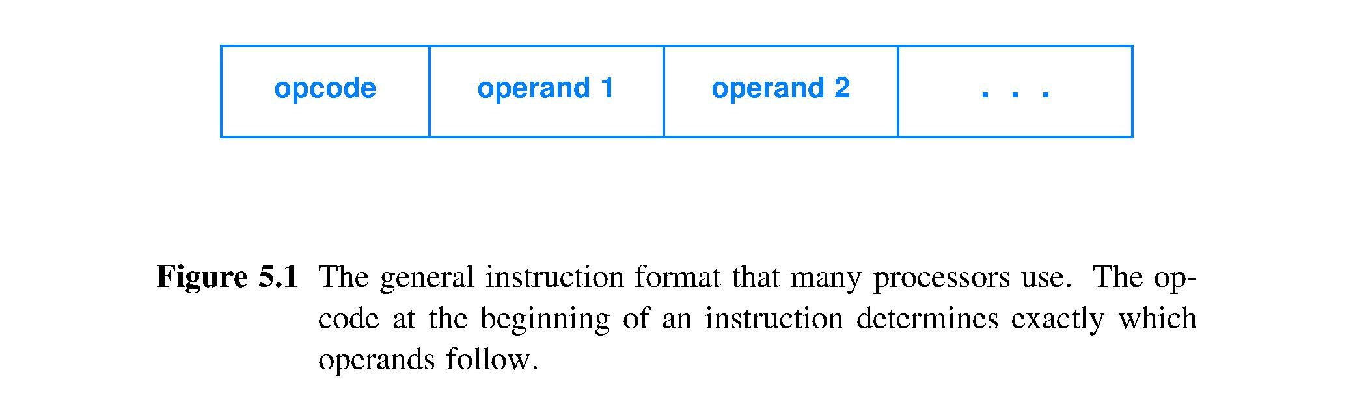
Instruction representation (format)
Instr. specifies: operation, operand(s), result(s)
∴ instr. format has multiple fields, generally
Format encodes instruction information
Must decode instruction to create voltages for all processor inputs

Slide 10
Instruction format size
Format size (# bits) is a design choice
Bigger → encode more meanings
Smaller → use less storage (memory HW)
Variable → attempt to combine big and small advantages
Other design criteria
Time cost of fetching an instruction
Time cost to decode an instruction
Monetary cost of memory hardware & other HW
Costs are a function of technology
Technology changes → Costs change

Slide 11
x86 ISA – variable length format
Intel x86 ISA uses variable length instructions
Established 1972 with 8008 CPU (18 pin DIP), when hardware very expensive, processor and memory run at similar speed (no performance penalty to access memory)
Common instrs. given short encodings; rare get longer encodings; reduces average instr. length, which reduces size of memory to store a program
Fetch and decoding are complicated, slow
How many bytes to fetch to obtain all of next instr.?
Decoding done byte by byte

Slide 12
ARM ISA – fixed length format
ARM Holdings introduced ARM ISA in 1985
Instruction format has 32 bits
Fetching an instruction is easy and fast
Read 32 bits from memory = 1 instr. fetched
Add 4 to byte address to point to next instr.
Decoding is easy and fast
Entire instruction arrives at decode circuit
Format fields boundaries easy to find
Format fields easy to identify

Slide 13
Variable-length versus fixed length
Instruction format design criteria | Variable length | Fixed length
Format conserves today’s relatively inexpensive memory space | Yes | No
Format obscures the location of the starting byte of the next sequential instruction until the current instruction is decoded (determining its length) thus delaying the start of the next fetch | Yes | No
Format is well-matched to tiny fetch circuits that patiently copy one byte at a time of instruction formats that are B-bytes long for B = 1, 2, 3, 4, 5, … | Yes | No

Slide 14
How are machine language instrs. used?
Variable length enables/encourages huge number of machine language instructions
Almost all machine language programs are written by machine, under direction from a compiler, translating from high-level language source code
Translation must guarantee correctness based on the limited information present in source code, so many variable-length machine instructions are never used

Slide 15
Newer ISAs use fixed-length instrs.
Why is fixed length preferred for today’s HW technology?
Amdahl’s Law – to achieve high performance be sure to make the common activity fast
Fixed length with easy to parse fields means
Fastest fetch (locate, copy, and deliver instr.)
Fastest decode (prepare Execute HW to act)
Fetch-Execute cycle shows that Fetch is a common activity
Also, fixed size means easy to build register to store the instr. bit string

Slide 16
CISC versus RISC
CISC – complex instruction set computer
Many instrs., including complex instrs. with high-propagation-delay circuits
Likely more than one instr. to compute a result, so which way to compile?
RISC – reduced instruction set computer
Few instrs., most execute in small # of gate delays
Just one way to obtain a result (orthogonal instrs.) so compilers easier to write
Newer ISAs are RISC-y

Slide 17
Instr. format design – Opcode field
A processor contains a circuit for each operation it performs; these circuits implement a specific truth table; they are located in the Arithmetic/Logic Unit (ALU)
HW uses opcode to point to one ALU circuit
∴ opcode field size is ⌈ log₂ # ALU ckts. ⌉; larger field → more built-in operations

Slide 18
Operands – what, when, where
What?
Some formats are built in to the HW, e.g., 32/64-bit unsigned integer, 32/64-bit 2’s complement integer, IEEE FP
Some are built by SW from byte strings, e.g., ASCII strings, structs
When?
Some are known early – constants in source code
Some are known only just in time for their use
Where? All operands must be brought (usually by copying) to inputs of correct circuit within the ALU

Slide 19
One of Three locations for operands
Immediate operand – operand bit string contained in an instruction format field
Access operand: Decode instr. locating operand field, place bit string on wires
Called “immediate” ∵ decode produces opcode and operand on wires simultaneously
Immediate operand must fit within instr. format
∴ immediate operand bit string likely shorter than built-in number formats, such as 32-bit unsigned integer or single-precision IEEE FP
Immediate operands will be small magnitude integers, characters, i.e., short bit strings
Immediate operands must be knowable at compile time

Slide 20
Two of Three locations for operands
Register – the Register Unit, or Register File, holds 2^{n} registers, typically 2^{n} ≤ 128 today
Registers build from logic gates; propagation delay same as simple computational circuits; ∴ register file easily keeps up with all ALU circuits
Pointer ≤ ⌈ log₂128 ⌉ = 7 bits = short bit string
∴ can afford an instr. format field to hold register pointer, ∴ register pointer an immediate operand
Access operand: (1) Decode instr. locating register pointer (2) Input pointer to Register File multiplexer (3) Register file returns copy of operand bit string on wires
Register operand locations set by compiler

Slide 21
General purpose registers
Used as temporary storage for operands and results
Have 2^{n} for n equals, say 4, 5, 6
General purpose registers all the same size
Great design choice: make integer operand bit string length, memory address length, and general purpose register size all the same
Very convenient for pointer arithmetic ∵ all operands and storage have matching size

Slide 22
FP registers
Usually processors with machine instructions for floating point arithmetic have a separate set of registers for FP operands and results
Opcode selecting an FP computational circuit will select operands from the FP register file and send the result to the FP register file
int a, b; float c; c = a + b; // unusual; ∴ no Amdahl’s Law // reason for HW to make this fast

Slide 23
Three of Three locations for operands
Memory – 1 of 2^{n} locations, typically n ≥ 32
Pointer (a.k.a. memory address) ≥ 32 bits
Too large to contain within instr. format
∴ pointer to memory not an immediate operand
Access operand: (1) Decode instr. to locate register pointer (2) Input pointer to multiplexer (3) Obtain copy of register contents (4) Modify register contents as needed (pointer arithmetic) (5) Send resulting pointer to memory multiplexer with “Read” command (6) Memory location returns copy of stored bit string on wires
Operand often does not exist in memory until after program is well under way

Slide 24
Aside: Relative speed of memory technologies
Today’s SRAM and DRAM computer memory technologies for large working memory (main memory) are much slower than the execute step by processors, so compilers try to avoid sourcing operands from main memory
Assuming processor clock frequency allows for computational circuit (execute step) with a propagation delay of up to 20 gate delays
SRAM access takes circa 20 to 200 gate delays
DRAM access takes circa 1000 to 2000 gate delays

Slide 25
Summary
Machine instruction specifies operation, operands, results with truth-table level detail
When what is known is important
What info is known in time to be compiled into the machine code? Time cost paid once.
What info must be computed by the machine at program run time? Time cost paid every time the program is run.
Operand locations
Only registers can provide access for reading and writing of bit strings at ALU circuit speeds
All other feasible storage technologies today are much slower to very much slower than registers

Slide 26
Summary
Today’s computer technology favors ISAs with
Fixed-length instruction representation
Faster fetch
Simpler field structure within representation
Easier, faster decode
ISA with instructions a compiler will actually use
Cheaper chip: fewer instructions implies a smaller circuit, implies smaller chip area: chip cost ∝ area
Lower power chip: simpler circuit, ∵ smaller ISA, needs less energy per unit time to operate
Omitting circuits for rarely used operations is analogous to omitting dead code from source

Slide 27
Lecture 16 – Pipelining fetch-execute
2018.02.14
The problem with big films is they snowball very rapidly and you can never pull back.
It's a pipeline that needs to be fed.
– Christopher Nolan
Director, screenwriter, producer

Slide 28
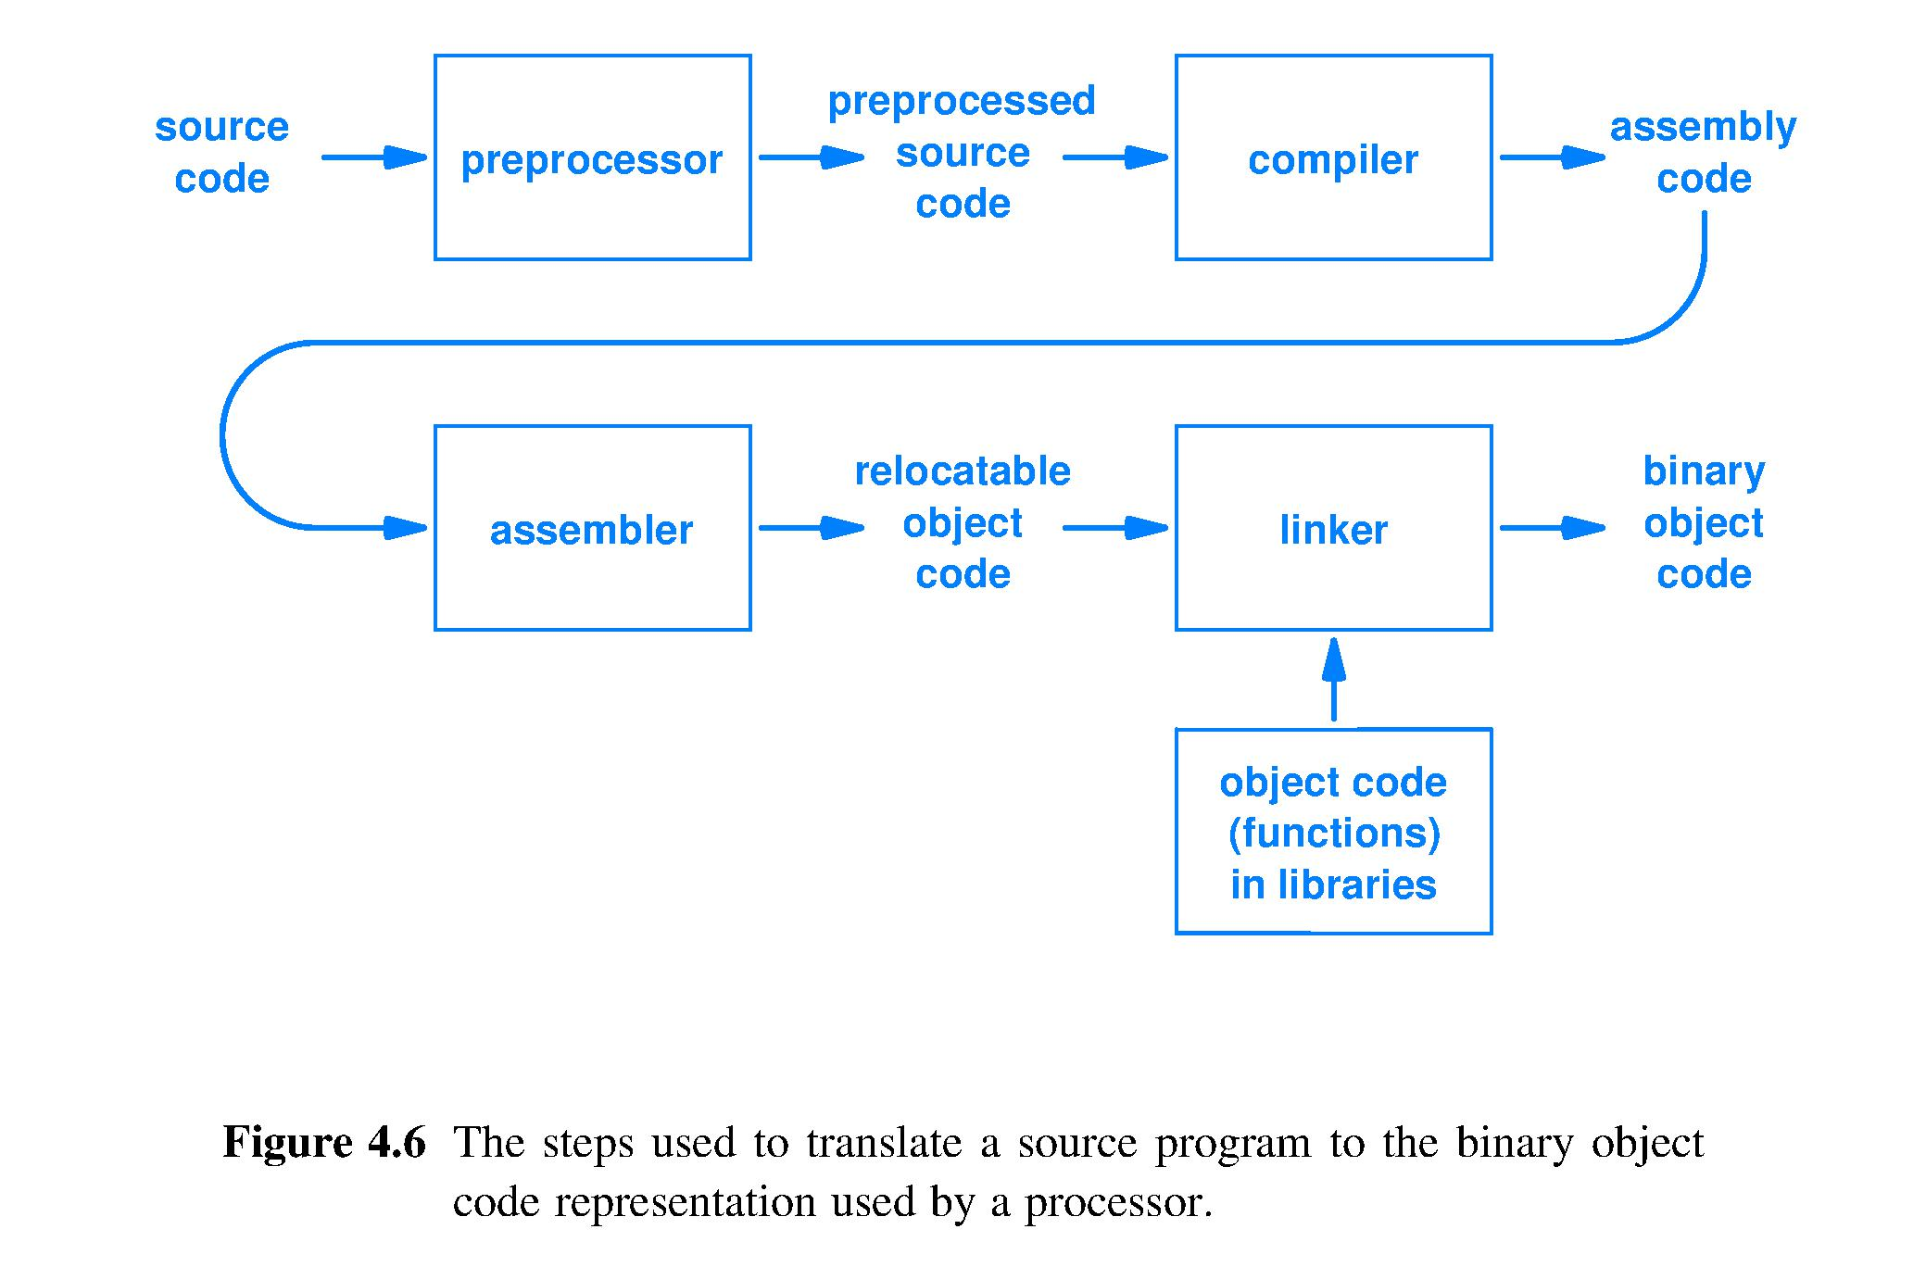
Program translation to stored machine code
loader
Instruction memory

Slide 29
Reminder – Fetch-Execute algorithm
At highest level of abstraction, a processor circuit is designed to do this:
Repeat forever* {
FETCH – access the next program instruction
from the location where it is stored.
EXECUTE – perform the action(s) described by the instruction.
}
*Provided the hardware receives power and has not been instructed to halt
Notes:
Simple, single purpose computers often do not have a HALT instruction: Apple TV, a microwave oven controller, …
For these computer systems, to stop execution we must remove the power source.

Slide 30
Where are instructions stored in memory?
Memory is a 1-dimensional (1-D) array of storage locations, one location after another, sequential
Programs are sequences of statements, 1-D
Simplest storage strategy:
Store instructions in sequential memory locations
Performance evaluation for fixed-length instr.:
Computing the address of the next location in a sequence requires only adding a fixed increment to the current_instr._pointer [simple and fast]
Fixed increment is # bytes in instr. format

Slide 31
Fetching an instruction
Use a register to hold memory location bit string
Use multiplexer to point to one location, copy instruction bit string, deliver to processor for decoding
Address of instr. to fetch (output of a register)
Compiled program
Memory
Location
Instruction
Mapped by loader
Location
to instruction Decoder
Instruction
Location
Instruction
Multiplexer
Location
Instruction
Location
Location

Slide 32
Fetching a sequence of instructions
Sequence of addresses sent to multiplexer determines instr. execution sequence
Determining address of next instr. is key
Done long ago
Unchanging locations
Sometimes do not know which instr. is next, but need next address at HW speed!
Compiled program
Memory
Location
Instruction
Mapped by loader
Location
Instruction
Location
to Decoder
Instruction
Multiplexer
Location
Instruction
Location
Location

Slide 33
Map Fetch-Execute to RISC hardware
Textbook 5.12, pages 92-93
Want more performance?
Replicate HW to accept more bits of input simultaneously thus producing more bits of results computed per unit time
Want yet more performance? Of course.
Then find a new dimension in which HW can “accept more work to do per unit time”
Try the 4th dimension, time
HW works on multiple instrs. simultaneously

Slide 34
Map Fetch-Execute to RISC hardware
Subdivide Fetch-Execute cycle into 5 steps
Fetch the next instruction
Decode the instruction and fetch operands
Perform the ALU operation, per the opcode
Perform a memory read/write, if LOAD/STORE
Store result to register file
Can subdivide Fetch-Execute in many ways, each a design choice
5-stage design is a classic pipeline

Slide 35
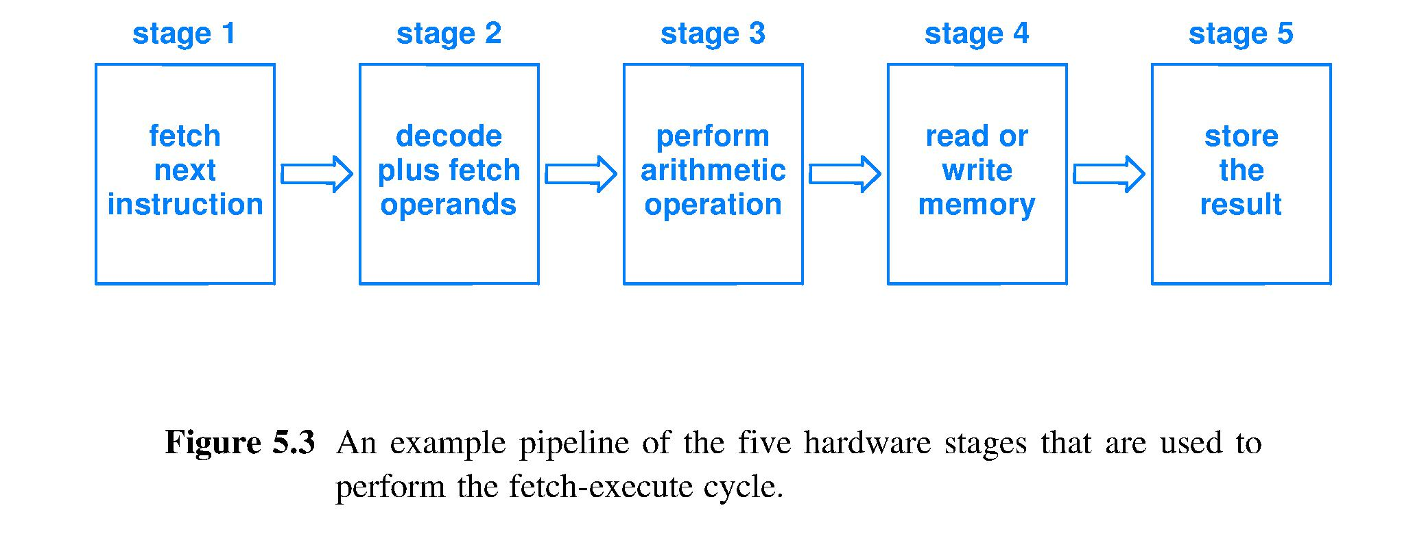
Go faster by being too “lazy” to be slow
Lazy idea: do not complete 1 instruction in 1 Fetch-Execute cycle; be lazy, do less per cycle
Split Fetch-Execute cycle into 5 stages that each do “~1/5 of the work, but in ~1/5 of the time”
If instrs. are independent, can fully overlap work
Instructions complete at a rate up to 5x faster
Fetch – Execute

Slide 36
Canonic 5-stage execution pipeline
Once a stage completes its subtask, it passes its “sub-result” to the next stage, then starts work on the next machine instruction

Slide 37
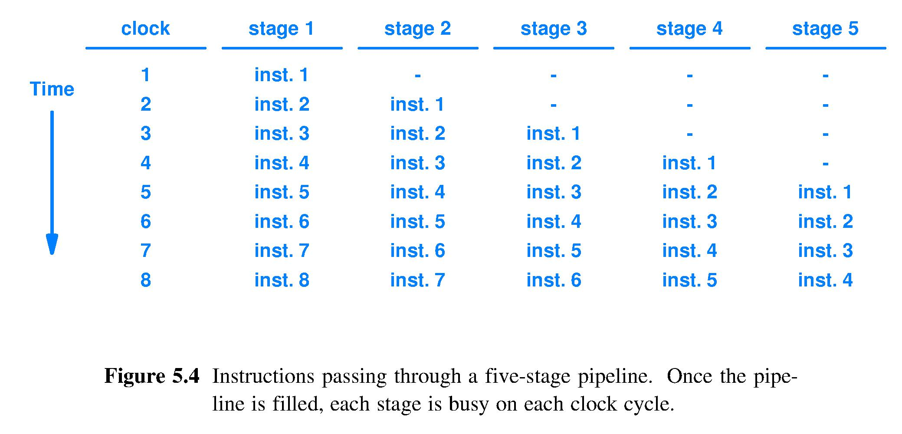
Ideal pipeline activity in space-time
Space (propagation through circuit)
Advancing

Slide 38
Instruction pipeline operation
Pipeline is transparent to programmers because the ISA contains no references to the pipeline structure of the circuit
Seamless instruction overlap in time requires instruction independence

Slide 39
Real-world pipelining – stalls
Stalls happen
Example stall due to a true data dependence (a.k.a. true data dependency), which means that an instruction computes a result that is used by a later instruction as an operand
Instr. K: C ← add A B ; write result C
Instr. K+1: D ← subtract E C ; read operand C
K must complete by writing C into a storage location before K+1 can read operand C from that location

Slide 40
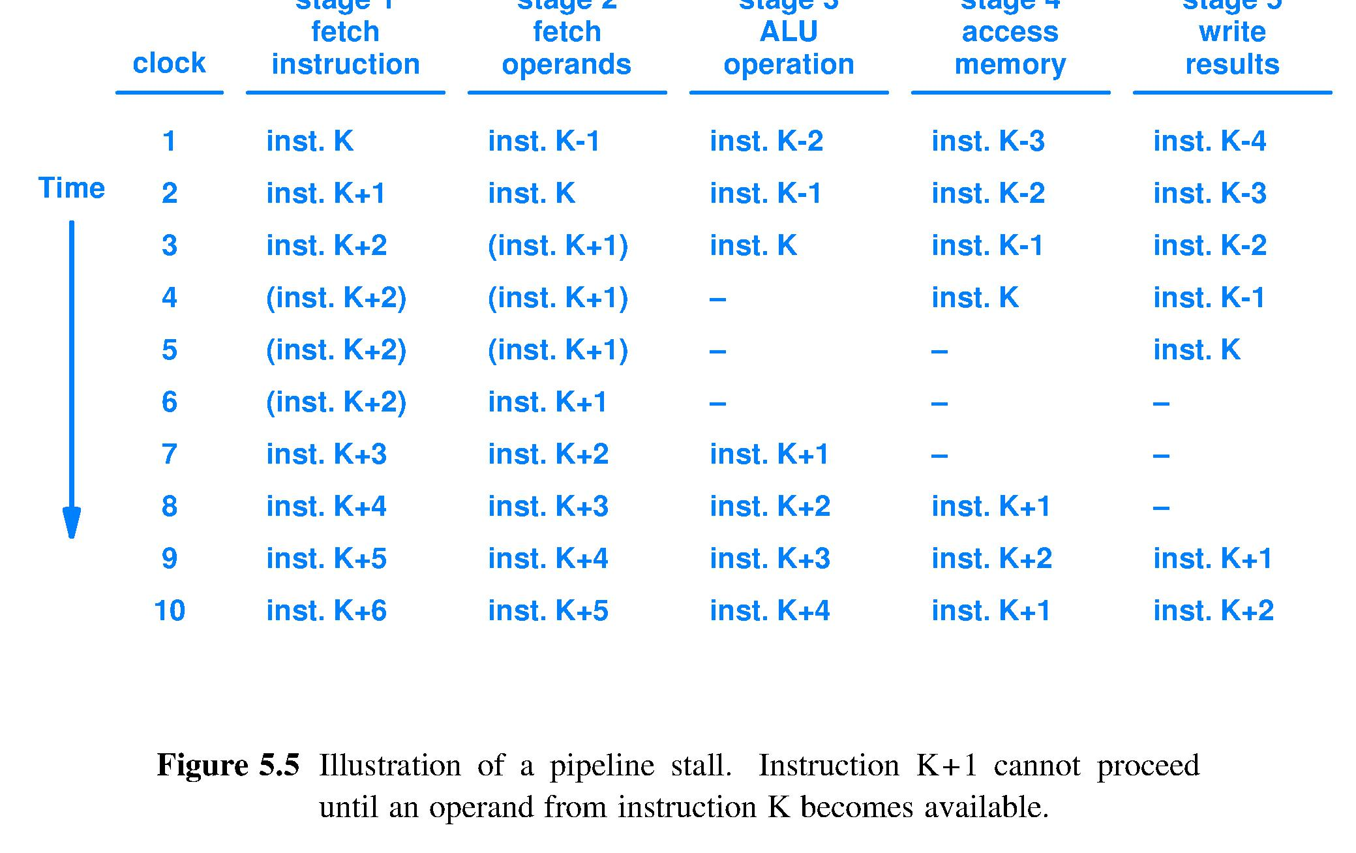
Pipeline stall due to instr. dependence
Inst.?
NOP1
NOP2
NOP1
NOP3
NOP2
NOP1
NOP3
NOP2
NOP3
MUST insert an instruction here, hardware MUST be told what to do; Yet, must NOT change program’s meaning; so ISA intended to be pipelined should be designed to include a NOP instruction; NOP means No OPeration (consume time but have no effects)

Slide 41
Inst. K+1 depends on K; stall until result written and detected (one of many design options)
NOP 1
NOP 2
NOP 1
NOP 2
NOP
NOP
NOP
NOP 3
NOP 1
NOP 3
NOP 2
NOP 3
Stalls filled with NOPs = 3 clocks wasted time = throughput loss
Textbook

Slide 42
Causes of pipeline stalls
Pipelines stall every time some stage cannot complete its work in time
Operand yet to be written so it can then be read [Decode stage cannot access operand in time]
Operand being read from slow storage [Access Memory stage trying to read DRAM, typically]
Do not yet know which instruction to fetch next [Program contains if statement, loop, subroutine call, etc.]
Et cetera, et cetera, et cetera

Slide 43
Hardware designers reducing stalls
Will add considerable circuitry to analyze the fetched stream of instructions, called the path of execution, to
Detect dependences between instructions and re-order the sequence of instructions after their fetch to reduce stalls [Scheduling]
Let an operand be found and fetched from a location other than the location pointed to by the instruction itself [Forwarding]
Guess the truth value of a conditional expression before it is computed and start fetching instructions on the guessed path of execution, maintaining the ability to clean up after a wrong guess [Speculation]

Slide 44
Compiler writers reducing stalls
Will incorporate much code to analyze the source and produce machine code incorporating
Optimized use of general purpose registers [Register allocation] to reduce instances of reading from slow storage
Reorder machine instructions to eliminate dependence-caused stalls [Instruction scheduling]
Strive to avoid introducing instr. dependences due to reuse of locations [Single assignment]
Perform [branch logic inversion], [operation strength reduction], [loop unrolling], and many more code transformations that yield a faster execution path through the machine code

Slide 45
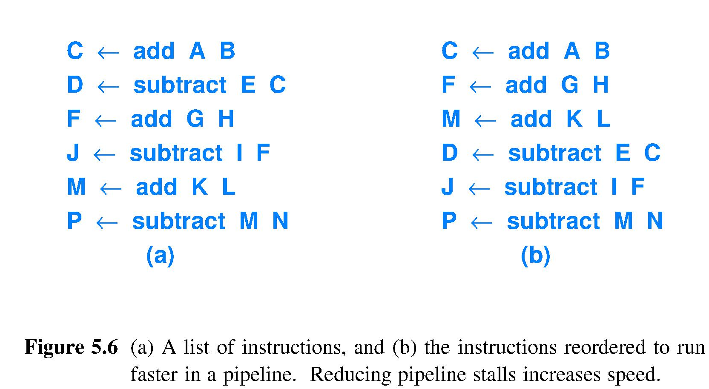
Example: compiler eliminating stalls
Have compiler optimize instruction order
Scheduled code; basic compiler performance optimization
Clock
Cycle
1
2
3
4
5
6
Original source code
Need C, F, M as ALU input immediately after ALU outputs C, F, M as results, too fast for register file.
Need C, F, M as ALU input after 3 intervening ALU operations; by then C, F, M will have reached register file and be readable from there.

Slide 46
Fetch-Execute with structured programs
Interesting programs include if-else, loops, and function calls
Program structures require ability to fetch more flexibly than just at the next sequentially stored instruction location
Instruction fetch location is controlled by the current_instruction_pointer aka program counter, which is stored in a register
∴ ISA includes instructions to load desired addresses into the current_instr._pointer
Text Algorithm 5.1 Execute line means this

Slide 47
Default fetch and branch instructions
Most of the time program instructions should be fetched in stored order from memory
Default_next_instr._ptr = Current_instr._ptr. + B where B is the size of the instr. format in bytes
Program structures require override of default next instruction fetch location
Absolute branch, aka jump, computes a memory address to use for next instr. fetch
Relative branch adds an offset other than B to the current_instr._pointer

Slide 48
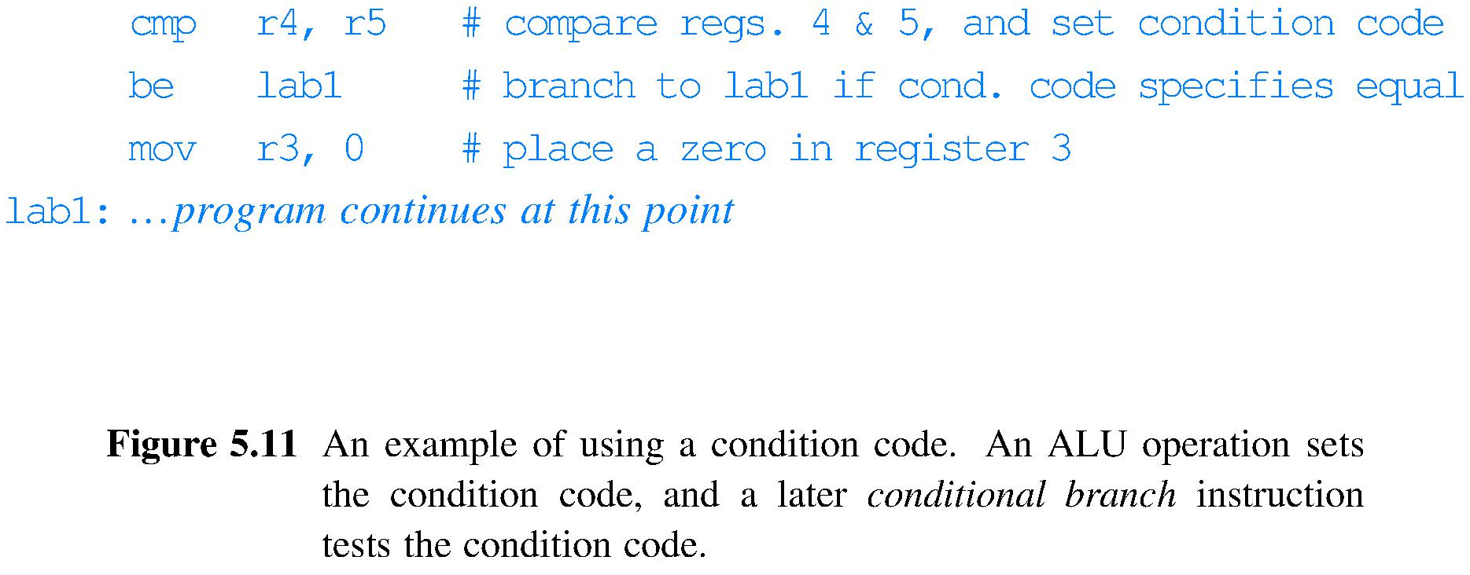
Default fetch and conditional branch
If-else and for loop program structures need to override the default fetch sometimes
Conditional branch overrides default next instruction location computation when a condition is true; example with branch if equal, written be

Slide 49
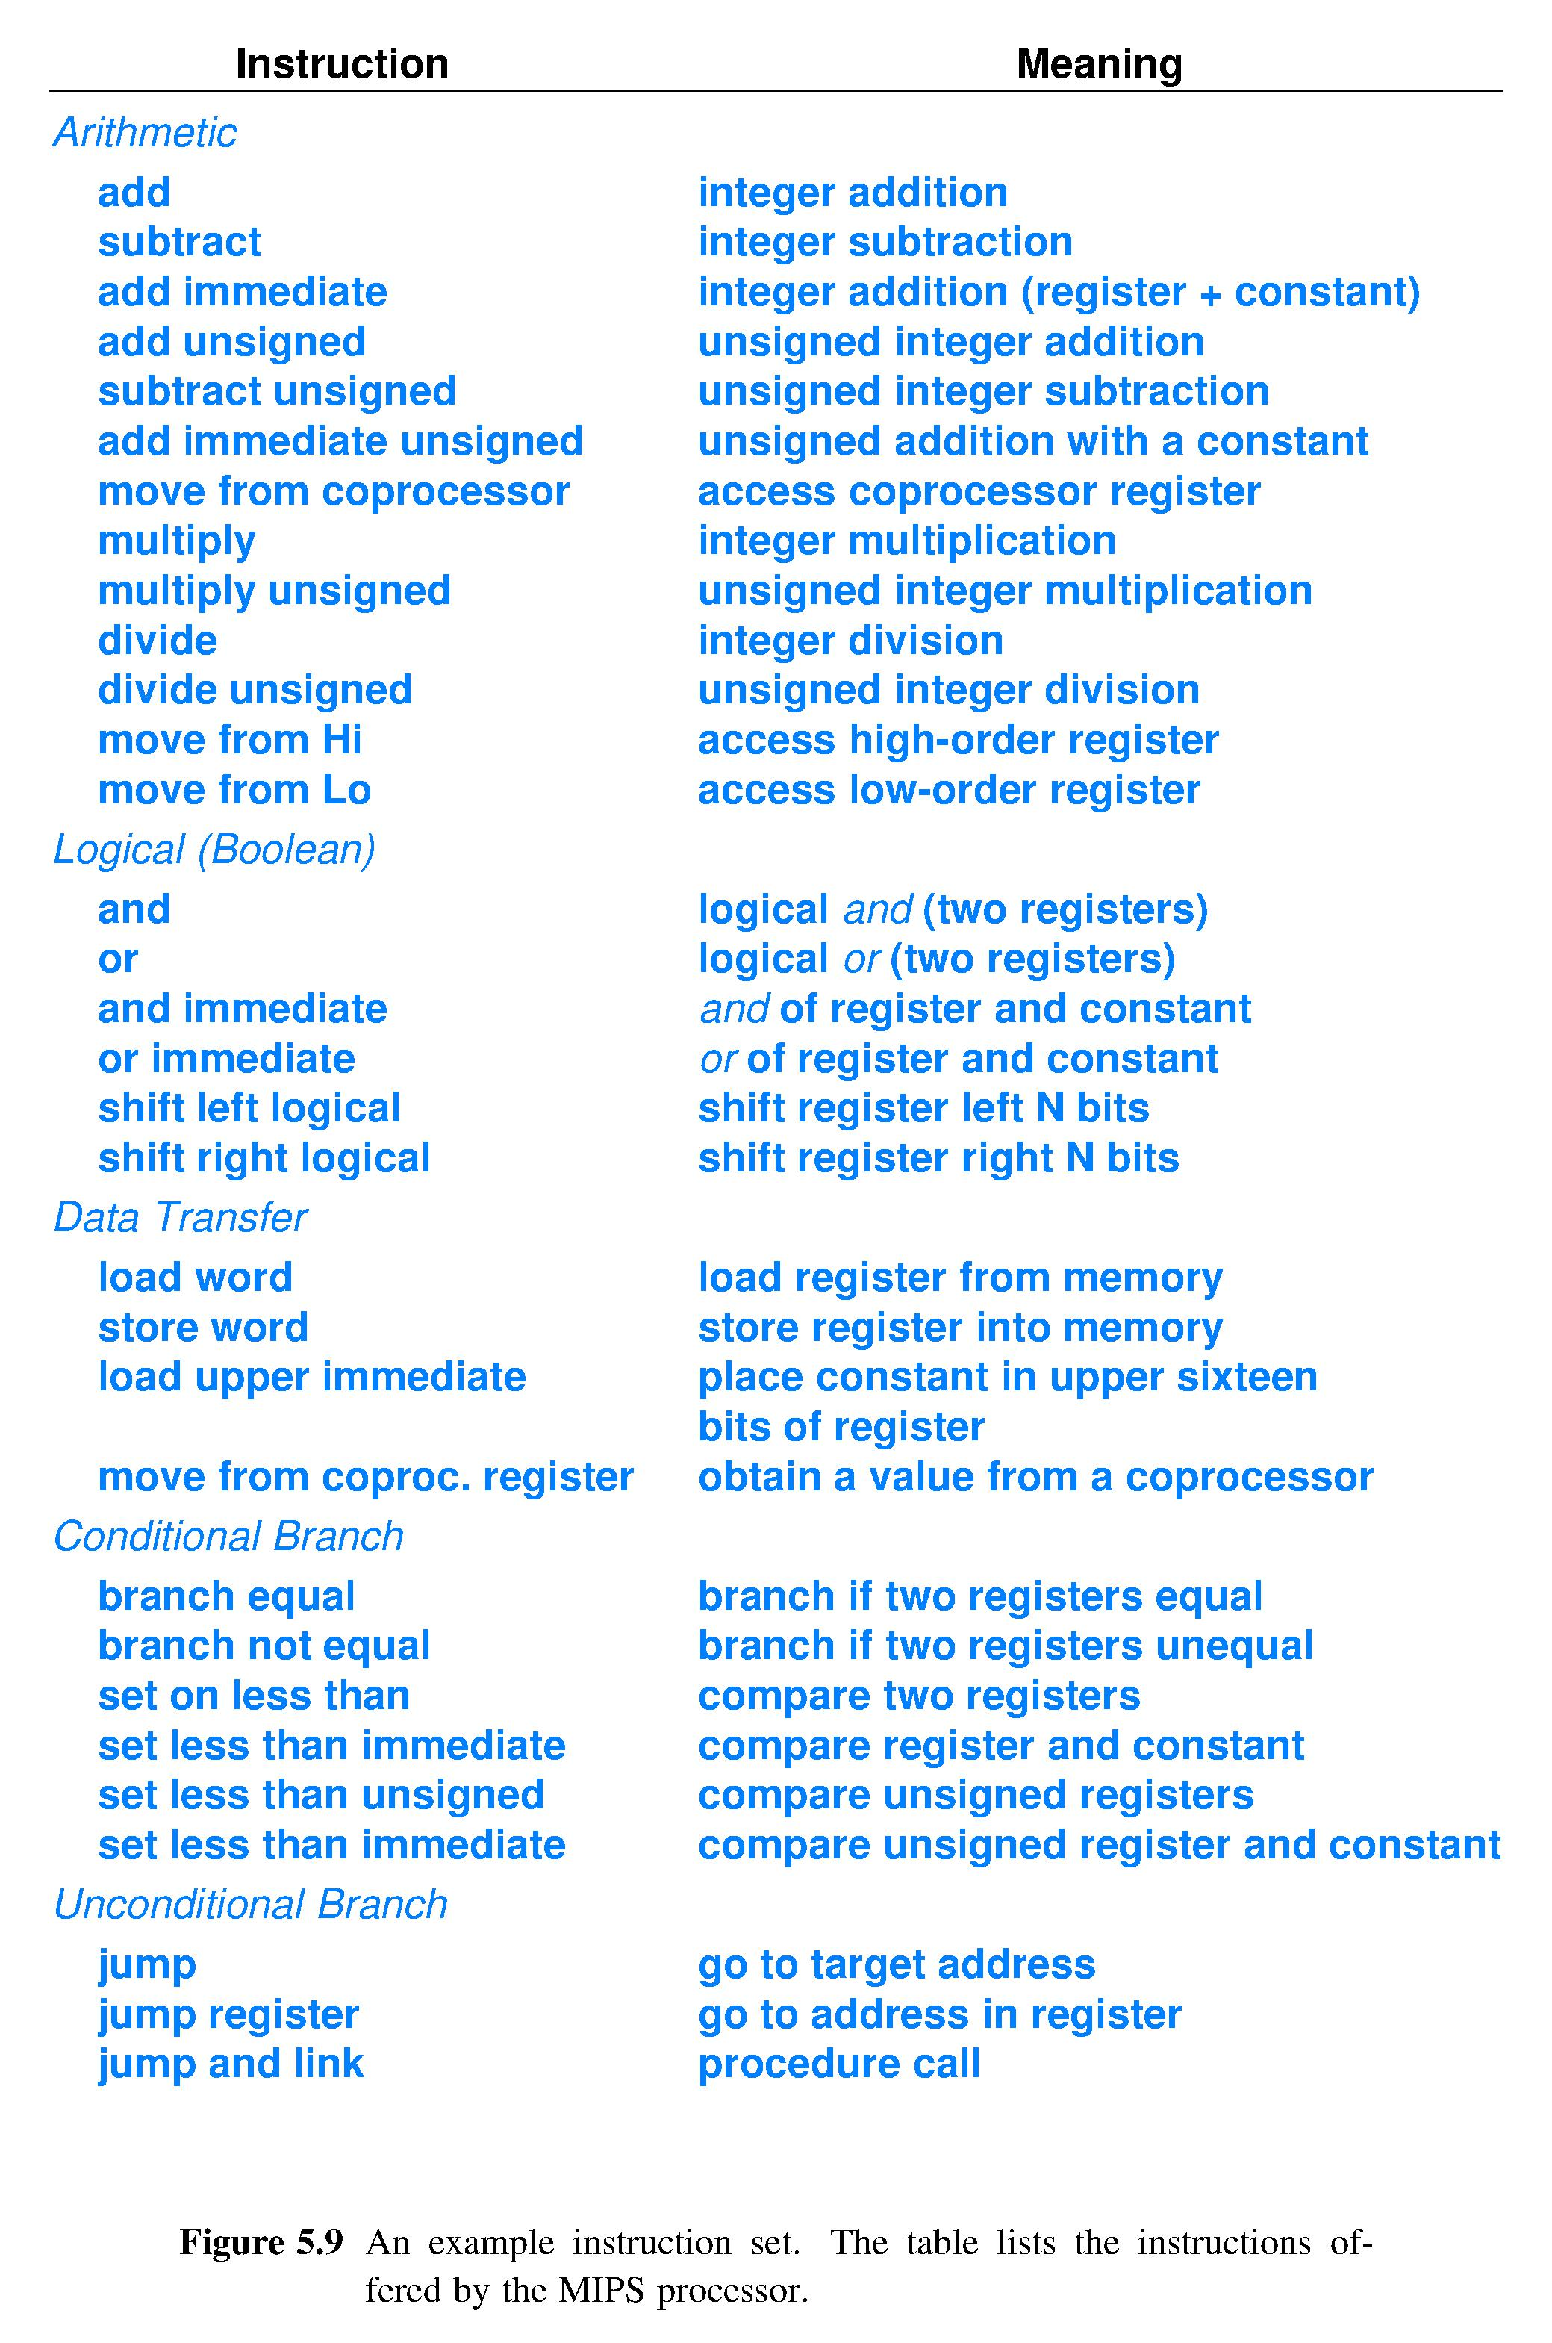
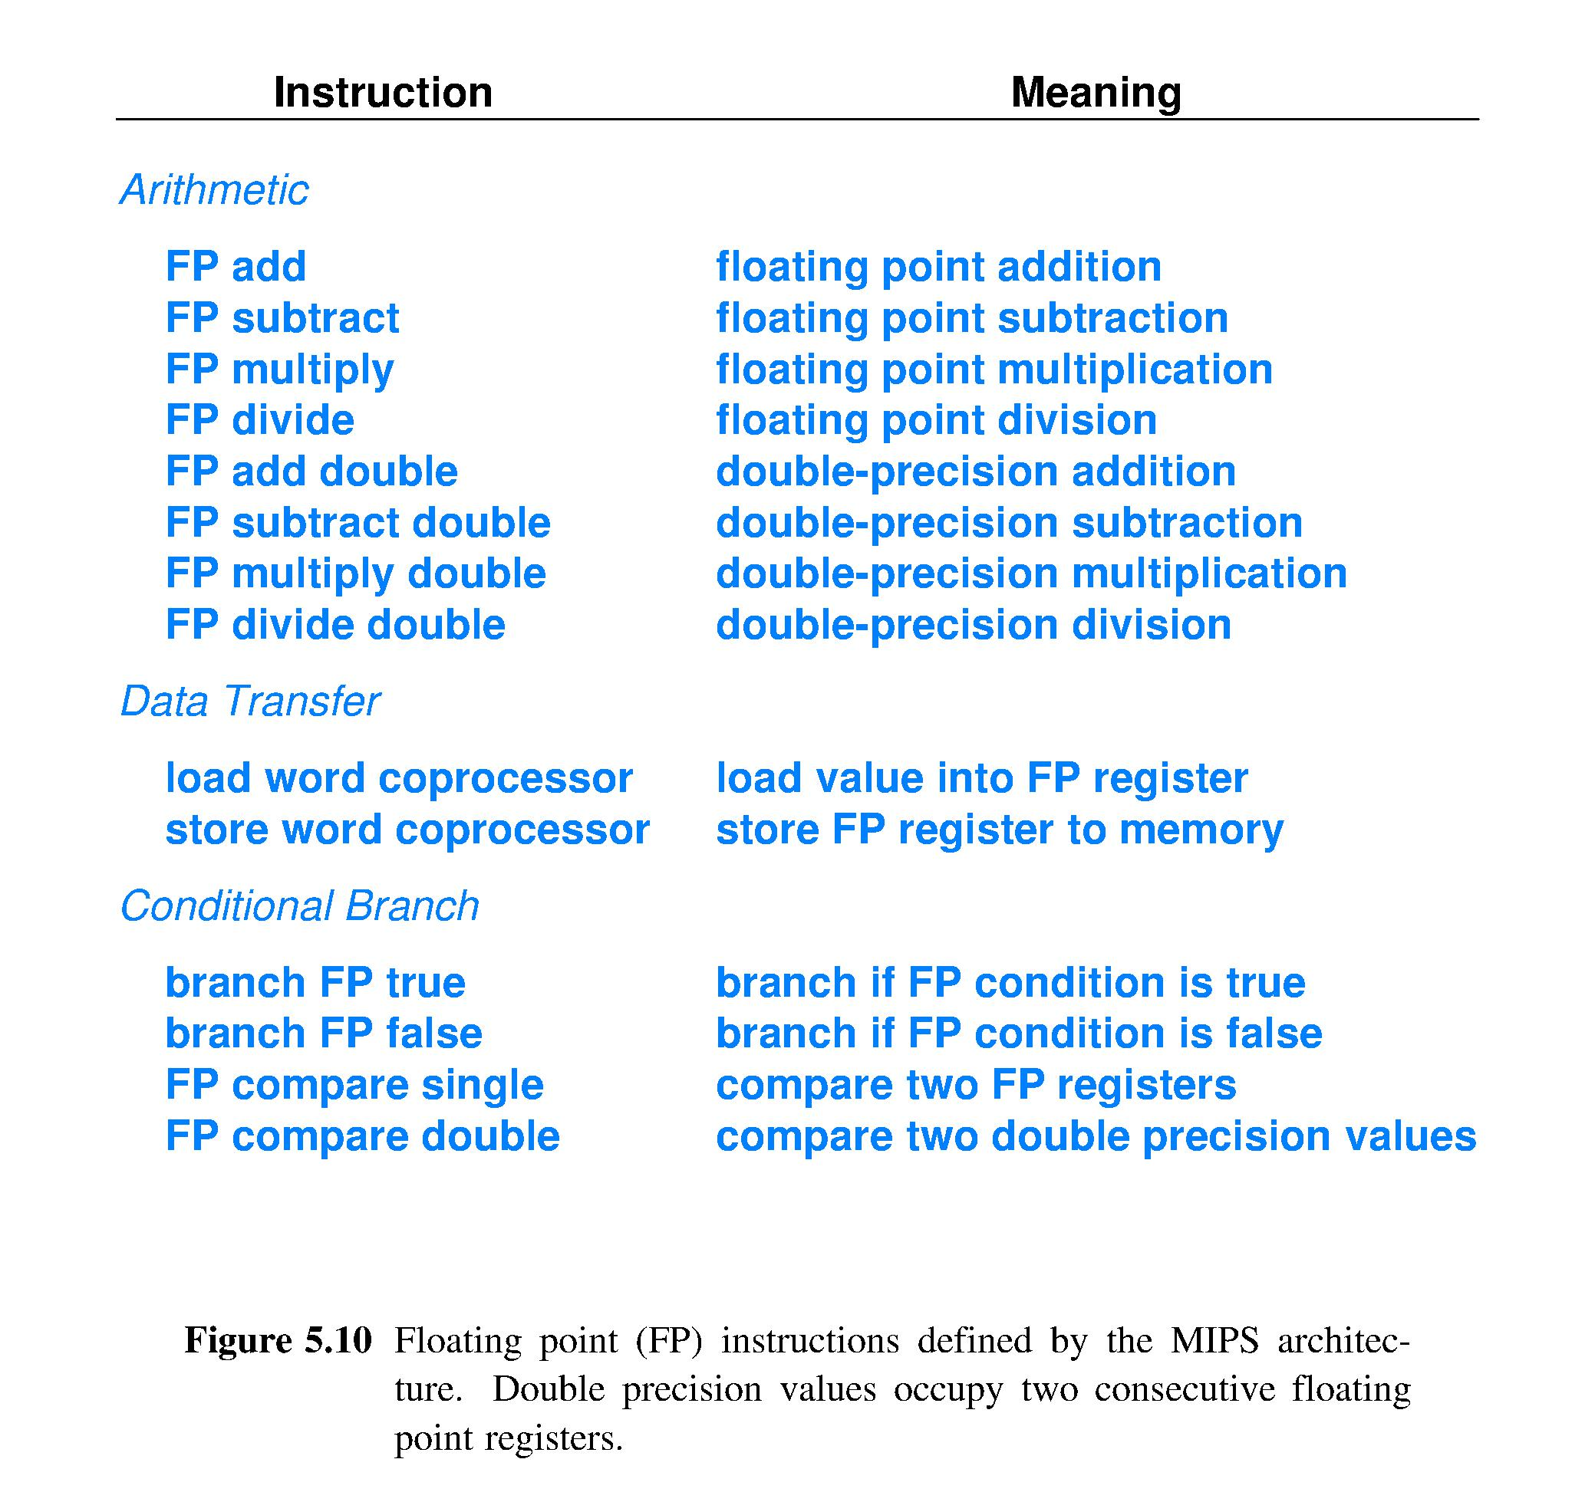
Example ISA – MIPS processor

Slide 50
ISA instruction grouping schemes
Different groupings emphasize different aspects of an ISA
Left column emphasizes function; right column emphasizes data movement, fetch location and operating mode
Textbook example | Another way
Integer arithmetic | } ^{Register-to-register}
Floating point arithmetic
Logical
Graphics
Data access and transfer | LOAD/STORE
Conditional and unconditional branch | } ^{Control}
Processor control

Slide 51
Announcements
Final Exam time and place: Wednesday, May 10:30am to 12:30pm in STEW 183, also known as Loeb Playhouse

Slide 52
Summary (chapter 5)
ISA – set of operations a processor can execute
CISC and RISC ISAs
Registers keep up with combinatorial logic
Pipelining completes more instrs. per second by breaking the fetch-execute cycle into a number of steps, each of which does a fraction of the work to complete an instruction
Pipelines can stall, wasting time; many HW and SW methods to reduce stalls
Conditional execution achieved via conditional branch instructions overriding the “+ B” default next instruction fetch address computation

Slide 53
Lecture 17 – The data path
2018.02.16
I started out with machine code and assembly language. – Charles Petzold
Microsoft MVP

Slide 54
Assignments
Today’s material from chapter 6

Slide 55

Components of a computer
Useful decomposition of computer components for design considerations: input and output (I/O), memory, and data path and control (processor)
Design the data path
Performance
Evaluation
Program Translation
Processor
Memory
Instructions
Input
User
Control
←Operands
Results →
Register File
Output
ALU
Delight

Slide 56
The data path (Chapter 6)
Design a circuit to perform
1) Fetch an instruction
2) Read operands from specified location(s)
3) Execute the instruction
4) Write the result into specified location
5) Repeat the above

Slide 57
Good design practice: 1 step at a time
Design requires considering options, making trade offs
Dividing a system design into a collection of subsystem design tasks is helpful

Slide 58
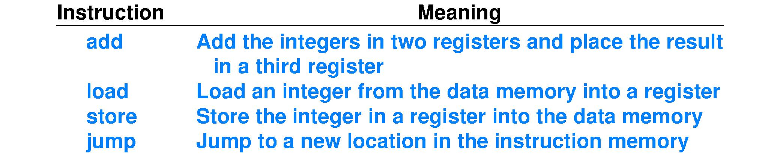
Choose the instruction set
Chapter 6, Fig. 6.1 develops an instruction set of four operations (tiny, instructive example)
add operands and result come from/go to registers
load and store copy between registers and data memory
data memory implies Harvard-style instruction set architecture (ISA)
load and store are elements of instruction set because today’s main memory technology is much, much slower than NAND-based circuits
jump supports code sequences other than purely sequential, called straight line code

Slide 59
Assembly language program
Assembly language expresses programs using the instruction set of the processor
Assembly instr. ; Comments load r2, 20(r1) ; r2 ← Data_Memory[20+r1] load r3, 24(r1) ; r3 ← Data_Memory[24+r1] add r4, r2, r3 ; r4 ← r2 + r3 store r4, 28(r1) ; Data_Memory[28+r1] ← r4 jump 60(r7) ; fetch at Instr._Memory[60+r7]
• r1, r2, r3, r4, r7 are ptrs. to registers; regs. store bit strings • “x ← y” means “x” receives the result of y • Memory[x] denotes the contents of memory at address x • 20, 24, 28 are immediate values encoded into an instr.; here they serve as an offset, an amount to add to a memory address held in a register (pointer arithmetic)

Slide 60
Assembly code is for humans
Example assembly instruction add r4, r2, r3
Bit string for add r4, r2, r3 in ASCII is 0x6164642072342C2072322C207233
Contains 28 0x digits, or 112 bits: so many hardware wires
Contains characters to aid human readability – spaces and commas – not needed as inputs to a logic circuit
Contains mnemonics to aid human readability – add, rX – unnecessary for logic circuit
An assembler maps (different from translating) assembly instructions onto a representation better-suited for logic circuit inputs, machine instructions
Assembly language has a 1-to-1 correspondence to voltages on wires in the processor hardware circuit
Notes:
Seeing “Nobody” in the instruction: unused offset field.
Circuit must be designed to ignore content of this field for the ADD instruction.

Slide 61
Define the instruction representation
Chap. 6 example develops 4 instructions, but let’s imagine that our little computer
has 32-bit instructions, 32-bit default integer size, and 32-bit memory addresses (when each of these important bit strings is the same size, the processor circuit is simpler, faster)
has up to 32 instructions
has 16 registers used to store operands and results
has immediate value integers with largest range
These four design choices are enough to fully define the instruction representation, or format

Slide 62
How the design choices set the format
“32-bit instructions” = instr. format is 32 bits
Opcodes are 5 bits because
“Up to 32 instructions” requires sufficient opcode bits to name ≤ 32 ≤ 2⁵, so 5 bits is enough
>5 opcode bits would deprive immediate integer operands of bit(s) and, thus, range
Register addresses are 4 bits because
4-bit addresses can point to 16 locations
Immediate values have all remaining bits
largest range of immediate values, implies “give all remaining bits in the format to immediate values”

Slide 63
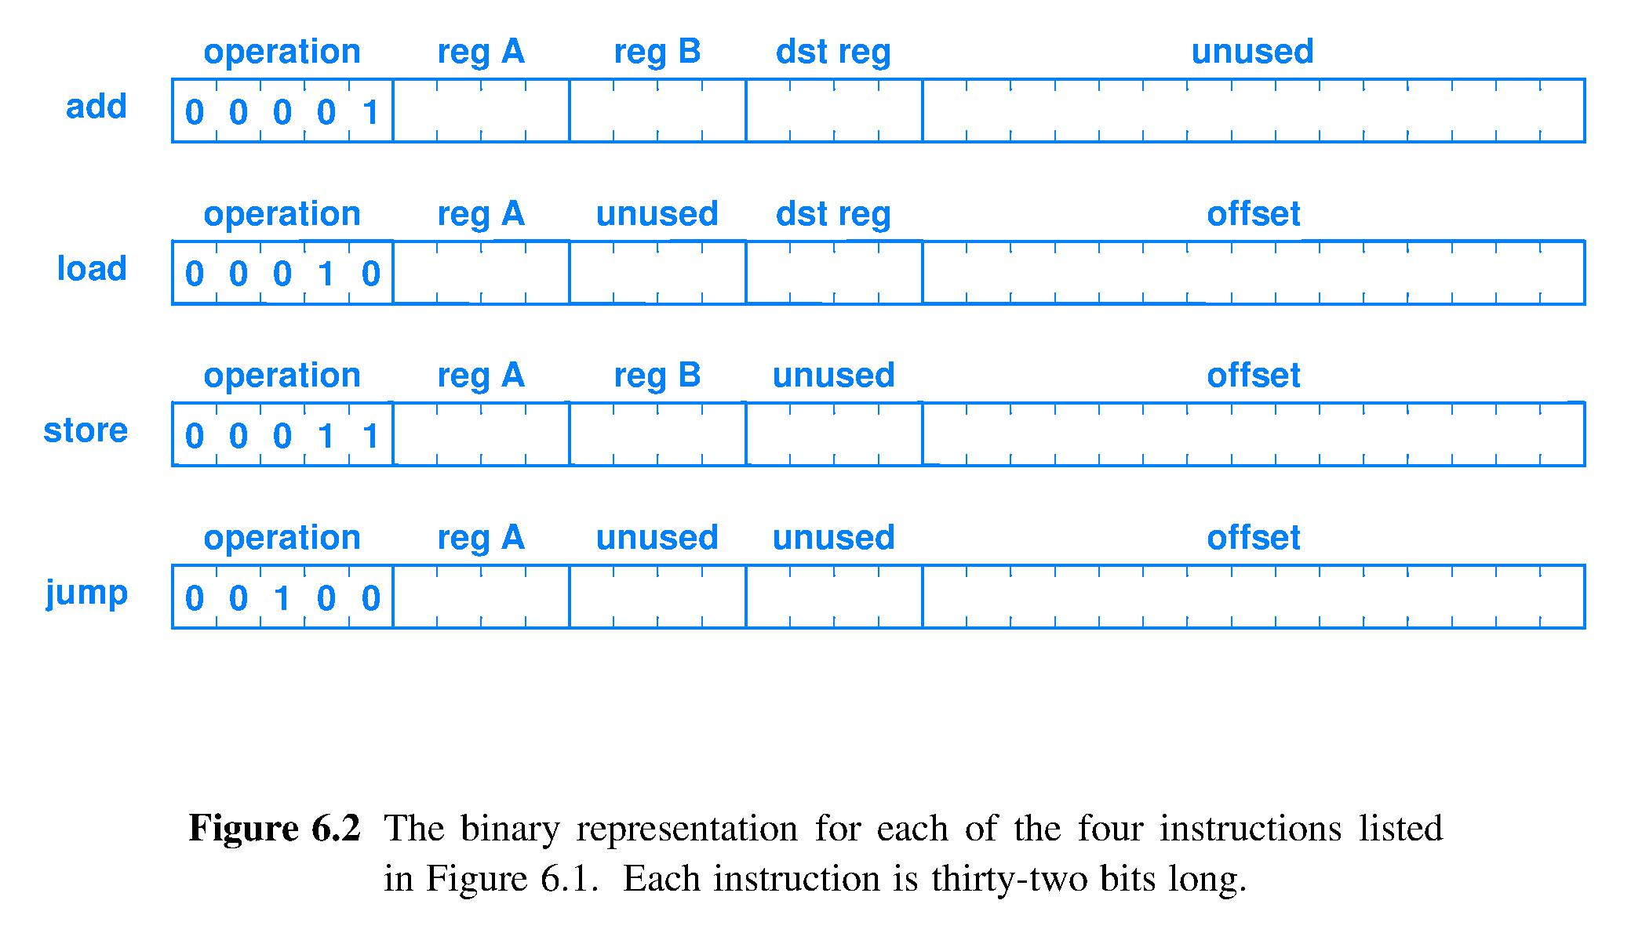
Instruction format example
Preceding translates to this format, ordering of fields within the bit string is a design choice
______ _____ _____ _____ ______________________ 5 bits 4 bit 4 bit 4 bit 15 bits (all the rest)

Slide 64
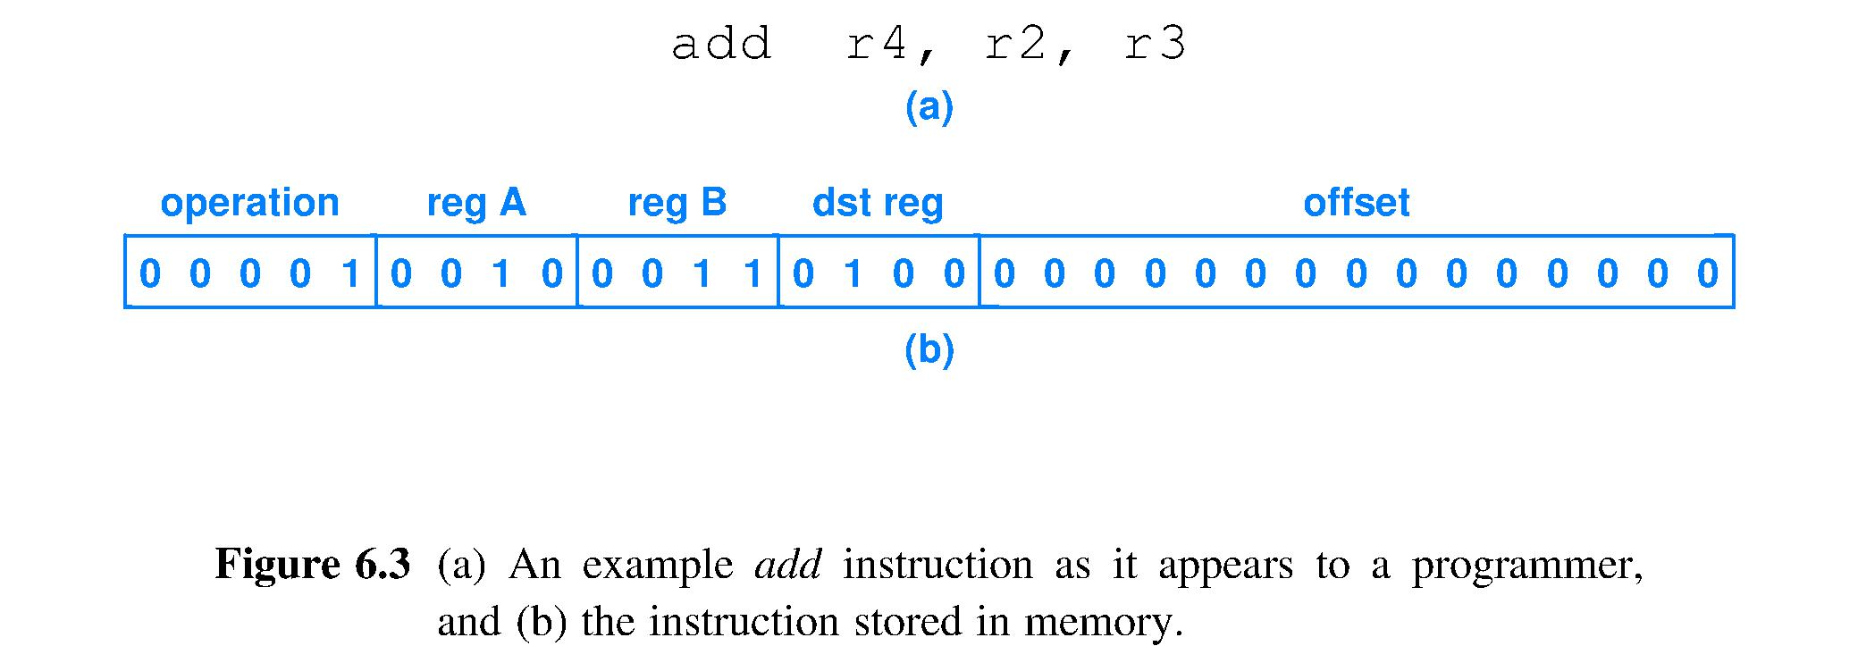
Assembly code to machine code
Consider this integer addition assembly language instruction add r4,r2,r3 ;contents[r4]←cnts[r2]+c[r3] ;register names are pointers
The assembler will map this character string to a machine language bit string in the chosen representational format, and the 1’s and 0’s correspond to voltages on wires in the circuit
Opcode PointerPointerPointer Unused offset, here set arbitrarily to all 0
Notes:
Seeing “Nobody” in the instruction: unused offset field.
Circuit must be designed to ignore content of this field for the ADD instruction.

Slide 65
Assembly to format correspondence
Assembly instr. ; Comments load r2, 20(r1) ; r2 ← Data_Memory[20+r1] load r3, 24(r1) ; r3 ← Data_Memory[24+r1] add r4, r2, r3 ; r4 ← r2 + r3 store r4, 28(r1) ; Data_Memory[28+r1] ← r4 jump 60(r7) ; Fetch at Instr._Memory[60+r7]
Corresponding instruction format representation load dst_reg, offset(reg_A) load dst_reg, offset(reg_A) add dst_reg, reg_A, reg_B store reg_B, offset(reg_A) jump offset(reg_A)
One-to-one correspondence of assembly to machine instruction format, but often field order is permuted

Slide 66
Assembly to pseudo-machine code
Assembly instr. ; Comments load r2, 20(r1) ; dst_reg, offset(reg_A) load r3, 24(r1) ; dst_reg, offset(reg_A) add r4, r2, r3 ; dst_reg, reg_A, reg_B store r4, 28(r1) ; reg_B, offset(reg_A) jump 60(r7) ; offset(reg_A)
Corresponding pseudo-machine code representation: still has X = don’t care for unused fields (Spaces are only for readability, Dreg = dst_reg) Opcode regA regB Dreg Offset 00010 0001 XXXX 0010 000000000010100 00010 0001 XXXX 0011 000000000011000 00001 0010 0011 0100 XXXXXXXXXXXXXXX 00011 0001 0100 XXXX 000000000011100 00100 0111 XXXX XXXX 000000000111100

Slide 67
Actual machine code
Assembly instr. ; Comments load r2, 20(r1) ; dst_reg, offset(reg_A) load r3, 24(r1) ; dst_reg, offset(reg_A) add r4, r2, r3 ; dst_reg, reg_A, reg_B store r4, 28(r1) ; reg_B, offset(reg_A) jump 60(r7) ; offset(reg_A)
Machine code showing one choice for values of X’s 00010000111110010000000000010100 00010000100000011000000000011000 00001001000110100101010101010101 00011000101000011000000000011100 00100011110011001000000000111100
These five 32-bit strings are how the processor sees this program: sequence of 5 collections of voltages on 32 wires

Slide 68
Machine code commands the circuit
Machine code example 00010000111110010000000000010100 00010000100000011000000000011000 00001001000110100101010101010101 00011000101000011000000000011100 00100011110011001000000000111100
A computer can be programmed by loading machine code bit strings into memory
No need for an OS, a compiler, or even a debugger
Programming directly onto the hardware is called “programming on the bare metal”

Slide 69
Time to: 1) Fetch instruction
Instructions are in memory; fetch one means Processor_control ← Memory[address of instr.]
Need circuit that can hold and output a 32-bit address to instruction memory: 32-bit register
Memory is addressed byte-by-byte
Fetch one instruction means give memory circuit address of first byte and have hardware designed to provide that byte and next 3 bytes sequentially
Thus, following 32-bit instr. will start at byte address = Current instruction address + 4

Slide 70
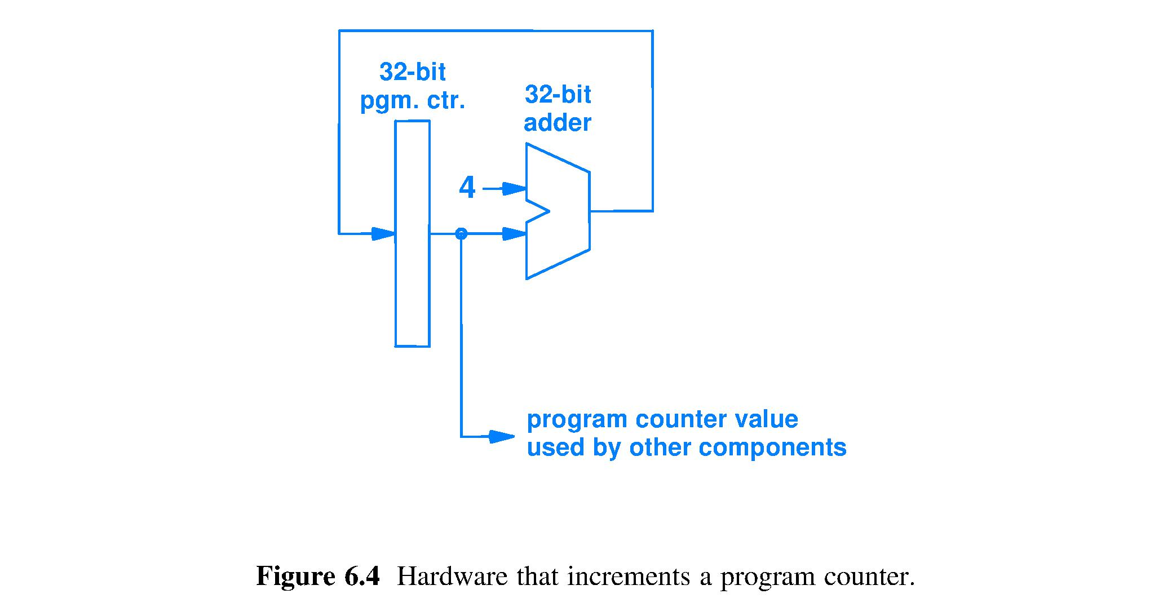
Fetch circuit – automating straight-line code
Register that holds Current_instruction_pointer (address) to the location in memory of the instruction to be fetched, also known as the Current Instruction
32 wires carrying the value Current_instruction_pointer + 4, also known as the Default_next_instruction_pointer
32
/
32
/
32
/
32
/
Symbol for integer adder circuit
Amount to add to point to the next instruction, given the design choice of a fixed-size, 4-byte long instruction format AND byte-addressed memory
32
/
This symbol actually represents many wires much of the time (abstraction). For clarity, when needed, we add a label showing the number of wires.
32 wires that connect to the address input of instruction memory
Notes:
There are no explicit types in hardware; you have to figure out the data type by context and thinking.

Slide 71
Fetch circuit is a sequential circuit
Combina-torial logic,
32-bit
integer adder
State register
Register
Clock
Clock
Program counter, which functions as the Current_instruction_pointer
Orange used to show information abstracted out of Chapter 6 figures
Fetch uses history (previous fetch location) to determine where to fetch next: sequential

Slide 72
Automating the execution of a program
If the CPU can fetch successive instructions of a program stored in memory, then the computer can run a program automatically
Fetch must be able to find successive instructions, as defined by the program
Control flow within the program must be obeyed
Subroutine call and return must be possible
Exit to the operating system needed
Use current_instruction_pointer to find instruction in memory

Slide 73
Current_instruction_pointer
Traditional name for the current_instr._pointer is the Program Counter
However, its circuit is a register, not a counter,
and circuit points to an instruction, not a program
RISC ISAs have fixed size instructions
Next instruction along the execution path of the program on a RISC computer is at one of
Current address + constant [straight line code], or
Current address ± increment [branch for control flow (if, while, switch, etc.), subroutine call], or
Absolute address [system interrupt handler, etc.}

Slide 74
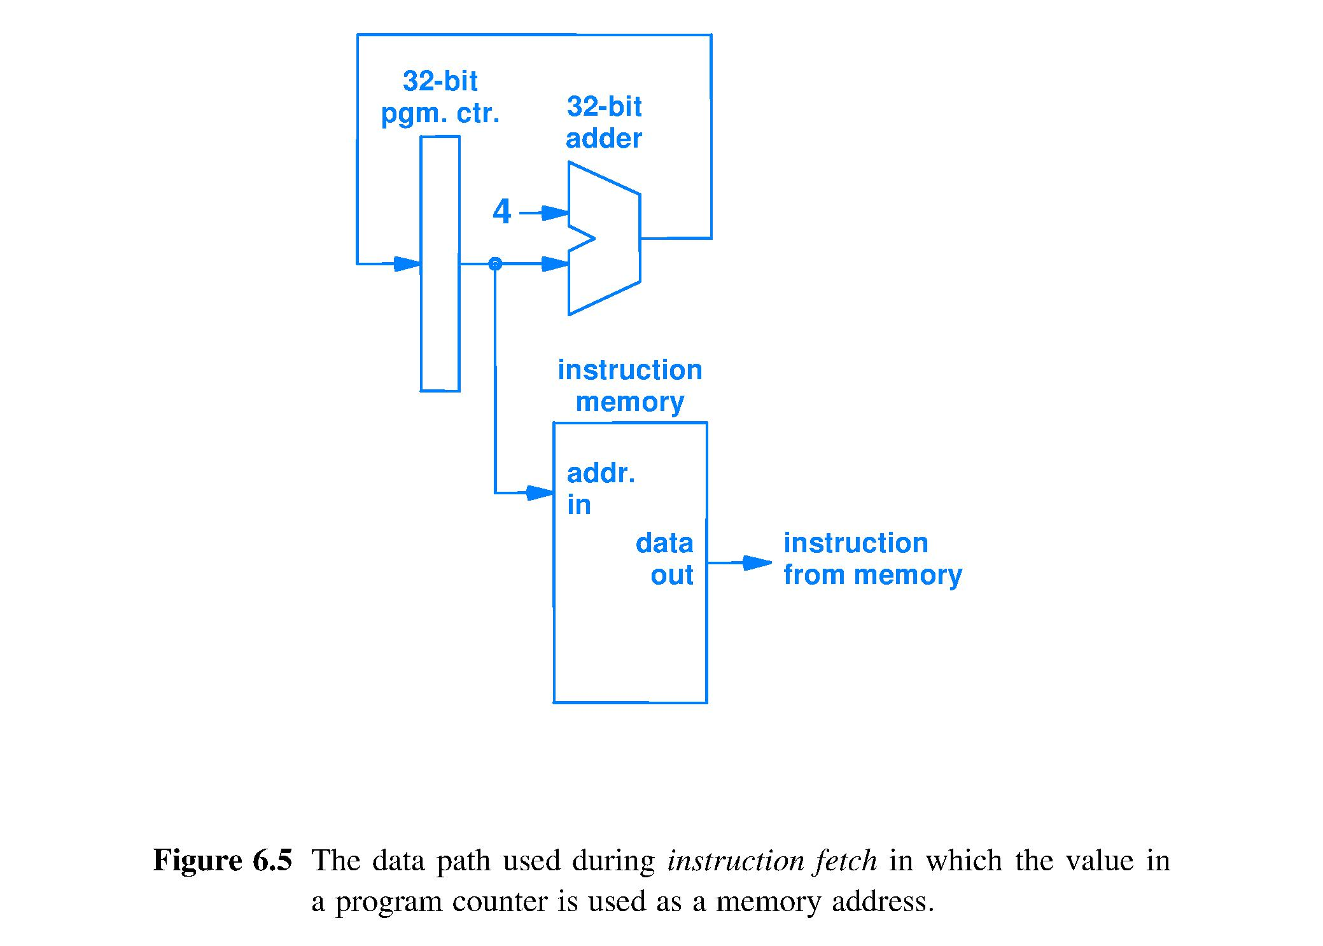
Connect fetch to instruction memory
Get a copy of the bit string at the location pointed to by address_in.
Send bit string to be interpreted as an instruction
Instruction memory input is a pointer, a bit string to be interpreted as an address

Slide 75
Summary
1 assembly language instruction = 1 machine language instruction
Many fields in machine language are pointers used to control mux and demux circuits to choose the path for data
Fetch done by a sequential circuit that updates the current_instr._ptr., traditionally known as the program counter

